Slide 1
Dynamo
Amazon’s Highly Available Key-value Store
Suma Dodmani, Austin Longo, Swathi Upadhya

Slide 2
Dynamo
Highly Available, and Scalable Distributed NoSQL Database service built on Amazon’s platform
Key - Value Storage Model
Designed for Massive Scalability
Decentralized System with minimum manual Intervention
Dynamo used by Applications to provide “Always - On” experience
Great fit for Mobile, Gaming, IoT, Web-Scale Applications, Social Networks
Notes:
Swathi

Slide 3











Dynamo Applications

Slide 4
Key Design Techniques of Dynamo
Consistent Hashing for data replication
Object Versioning to achieve consistency
Quorum to maintain data consistency through reads and writes
Gossiping for failure detection
Decentralized System with very little manual intervention

Slide 5
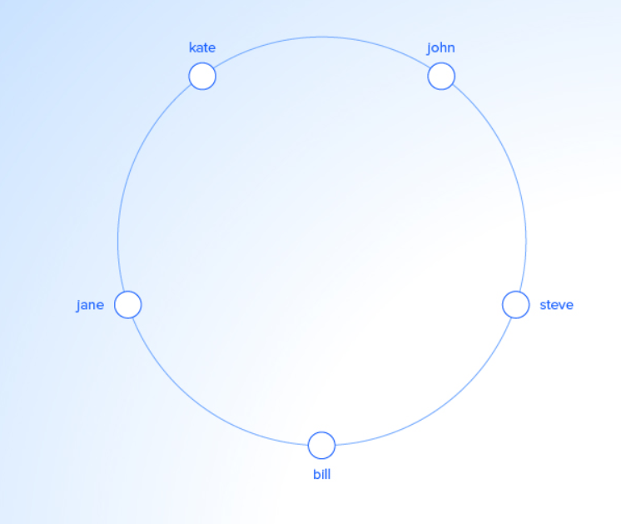
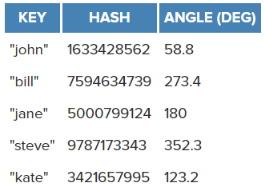
Consistent Hashing

Slide 6
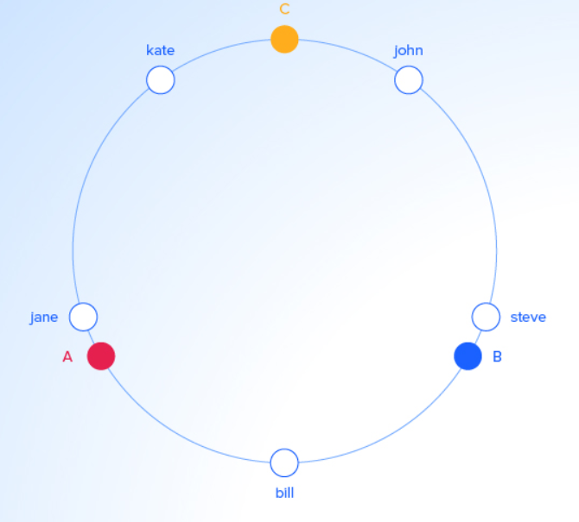
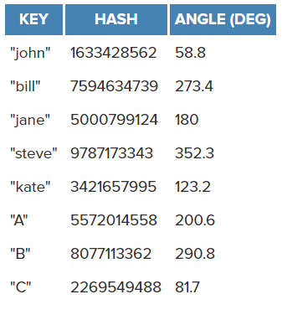
Consistent Hashing

Slide 7
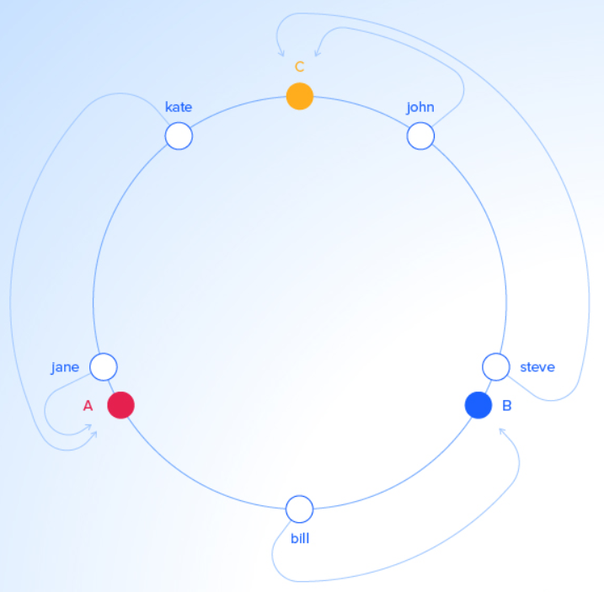
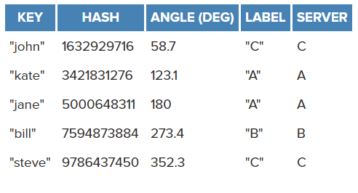
Consistent Hashing

Slide 8
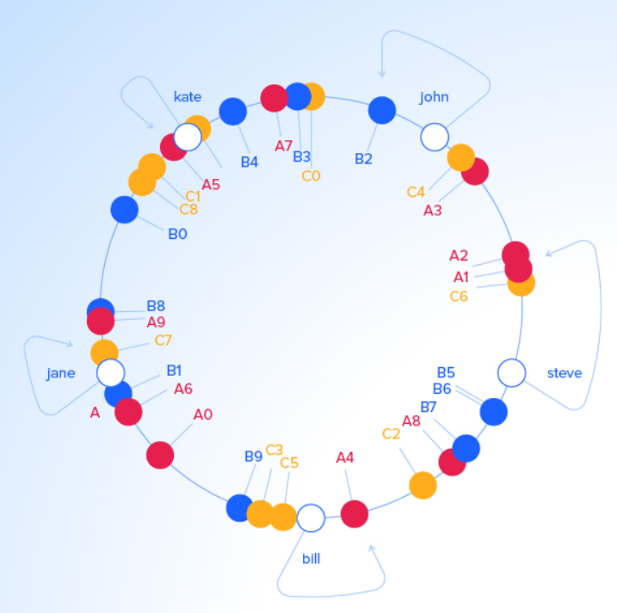
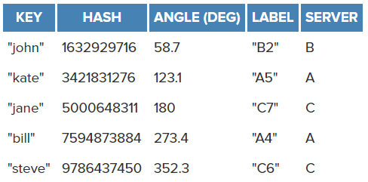
Consistent Hashing

Slide 9
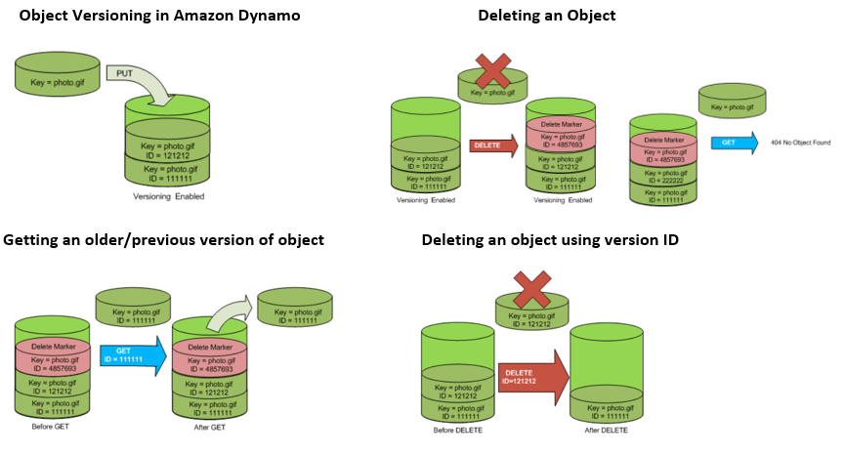
Object Versioning

Slide 10
System Assumptions and Requirements
Query Model - Simple Read/ Write Operations to data item that is uniquely identified by key
ACID - Prefers Availability over Consistency, No Isolation guarantees
Efficiency - Stringent Latency Requirements to meet SLAs

Slide 11
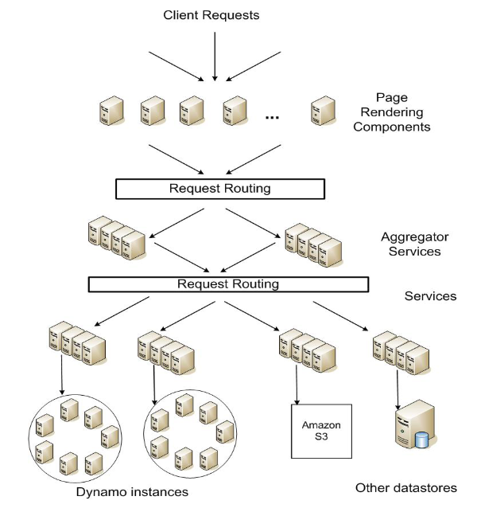
Service Level Agreements (SLAs)
Application delivers the functionality in bounded time. So, each and every dependency in the platform will have to deliver it’s functionality with even tighter bounds.
Evaluating Performance Oriented SLA - 99.9th percentile of Distribution

Slide 12
Design Considerations
Prefers Availability over Consistency
Eventually Consistent with data updation to replicas in background
Always writable data store, update conflicts resolved during reads - “Always Writeable”
System or Application perform conflict resolution
Incremental Scalability
Symmetry
Decentralization
Heterogeneity

Slide 13
When is Dynamo used?
Always writable data store
Built for infrastructure within Single Administrative Domain - Trusted nodes
No support for Hierarchical Namespaces - Simple Key/Value Store
Built for latency sensitive applications
Zero - Hop Distributed Hash Table
Does not focus on data integrity and security

Slide 14
System Architecture
Notes:
Austin

Slide 15
System Interface
get(key)
return: Object associated with key & context
put(key, context, object)
Places the object on replicas determined from the MD5 hash of the key

Slide 16
Techniques
Problem | Technique | Advantage
Partitioning | Consistent Hashing | Incremental Scalability
High Availability for writes | Vector clocks with reconciliation during reads | Version size is decoupled from update rates.
Handling temporary failures | Sloppy Quorum and hinted handoff | Provides high availability and durability guarantee when some of the replicas are not available.
Recovering from permanent failures | Anti-entropy using Merkle trees | Synchronizes divergent replicas in the background.
Membership and failure detection | Gossip-based membership protocol and failure detection. | Preserves symmetry and avoids having a centralized registry for storing membership and node liveness information.

Slide 17
Partitioning
Problem | Technique | Advantage
Partitioning | Consistent Hashing | Incremental Scalability
High Availability for writes | Vector clocks with reconciliation during reads | Version size is decoupled from update rates.
Handling temporary failures | Sloppy Quorum and hinted handoff | Provides high availability and durability guarantee when some of the replicas are not available.
Recovering from permanent failures | Anti-entropy using Merkle trees | Synchronizes divergent replicas in the background.
Membership and failure detection | Gossip-based membership protocol and failure detection. | Preserves symmetry and avoids having a centralized registry for storing membership and node liveness information.

Slide 18
Partitioning Algorithm
Provides a scheme for distributing load across all participating storage hosts.
Uses the MD5 128-bit hash function on an object’s key to determine which server(s) should host the object.
2¹²⁸ ≈ 340,282,366,920,938,000,000,000,000,000,000,000,000

Slide 19
The Ring
2¹²⁸
0

Slide 20
Hashing
2¹²⁸
0
hash(“ProdID-101”)
↓
79054025255fb1a26e4bc422aef54eb4

Slide 21

Partitioning
A
D
A
B
C
D
B
C

Slide 22
Distribution
A
D
B
79054025255fb1a26e4bc422aef54eb4
C

Slide 23
Virtual Nodes
A
B
C
D
79054025255fb1a26e4bc422aef54eb4

Slide 24
Virtual Nodes
Advantages:
Node failure proportionately affects all other nodes
Node addition proportionately alleviates load on all other nodes
Can account for heterogeneous node sizes.

Slide 25
Replication
Increases data durability by replicating N copies of data, where N is configurable.
Each key is assigned a coordinator node who has the job of replicating the data to its N-1 successors in the ring.

Slide 26
Replication
N = 3
A
B
C
D
Coordinator
79054025255fb1a26e4bc422aef54eb4

Slide 27
get() & put()
get() and put() requests can be received by any node, but will ultimately be forwarded to one of the top N nodes in the key’s preference list.
Request Forwarding:
Generic load balancer
Partition-aware routing

Slide 28
Data Versioning
Problem | Technique | Advantage
Partitioning | Consistent Hashing | Incremental Scalability
High Availability for writes | Vector clocks with reconciliation during reads | Version size is decoupled from update rates.
Handling temporary failures | Sloppy Quorum and hinted handoff | Provides high availability and durability guarantee when some of the replicas are not available.
Recovering from permanent failures | Anti-entropy using Merkle trees | Synchronizes divergent replicas in the background.
Membership and failure detection | Gossip-based membership protocol and failure detection. | Preserves symmetry and avoids having a centralized registry for storing membership and node liveness information.

Slide 29
Data Versioning
Provides a mechanism for eventual consistency that increases availability for writes.
Allows multiple versions of the same data to exist simultaneously.
Uses vector clocks to capture causality between versions.
Resolves version branching via syntactic reconciliation (automatically) or semantic reconciliation (manually by the client).

Slide 30
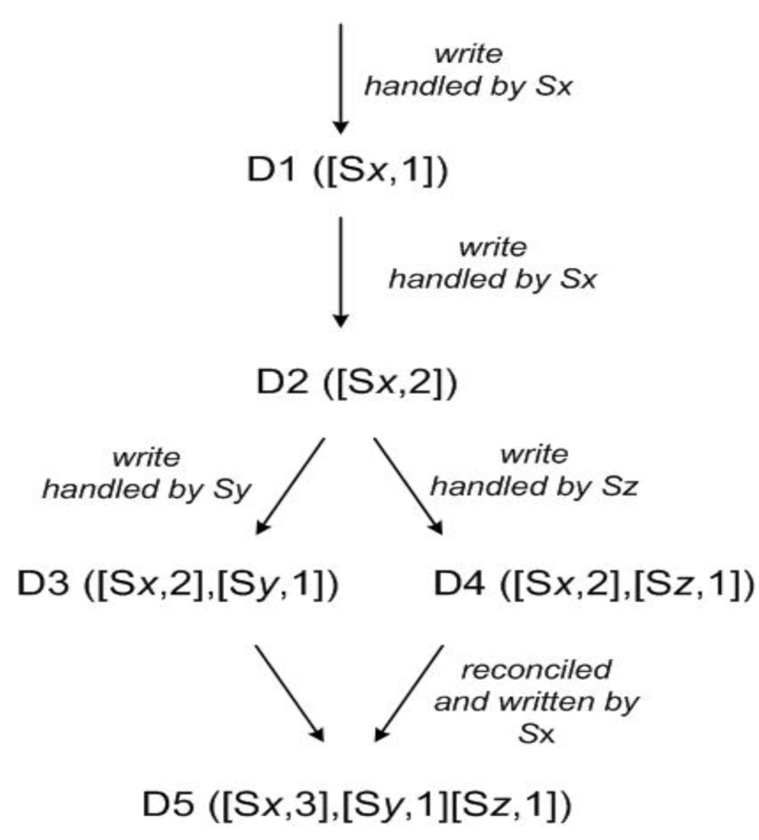

Client

Slide 31
Quorum
Consistency is maintained using a quorum protocol:
R + W > N
R: Number of healthy replicas that need to participate in a successful read operation.
W: Number of healthy replicas that need to participate in a successful write operation.
Reduces response time when R < N or W < N.

Slide 32
Hinted Handoff
Problem | Technique | Advantage
Partitioning | Consistent Hashing | Incremental Scalability
High Availability for writes | Vector clocks with reconciliation during reads | Version size is decoupled from update rates.
Handling temporary failures | Sloppy Quorum and hinted handoff | Provides high availability and durability guarantee when some of the replicas are not available.
Recovering from permanent failures | Anti-entropy using Merkle trees | Synchronizes divergent replicas in the background.
Membership and failure detection | Gossip-based membership protocol and failure detection. | Preserves symmetry and avoids having a centralized registry for storing membership and node liveness information.

Slide 33
Hinted Handoff
Sloppy quorum only requires the top N healthy nodes to participate in the operation.
In the event that one or more of the top N nodes for a key are unavailable, hinted handoff stores temporary copies of that key’s object on nodes further down the list. These copies contain a hint to allow them to be sent back to the correct node when it becomes available.

Slide 34
Hinted Handoff
N = 3
A
B
C
D
Coordinator
79054025255fb1a26e4bc422aef54eb4

Slide 35
Hinted Handoff
N = 3
A
B
C
D

Slide 36
Replica Synchronization
Problem | Technique | Advantage
Partitioning | Consistent Hashing | Incremental Scalability
High Availability for writes | Vector clocks with reconciliation during reads | Version size is decoupled from update rates.
Handling temporary failures | Sloppy Quorum and hinted handoff | Provides high availability and durability guarantee when some of the replicas are not available.
Recovering from permanent failures | Anti-entropy using Merkle trees | Synchronizes divergent replicas in the background.
Membership and failure detection | Gossip-based membership protocol and failure detection. | Preserves symmetry and avoids having a centralized registry for storing membership and node liveness information.

Slide 37
Replica Synchronization
To maintain durability replicas are kept in sync using Merkle trees.

Slide 38
Merkle Syncing
Replica 0
Replica 1
Top Hash
Top Hash
Hash 0
Hash 1
Hash 0
Hash 1
Hash 0-0
Hash 0-1
Hash 1-0
Hash 1-1
Hash 0-0
Hash 0-1
Hash 1-0
Hash 1-1
…
…
…
…
Data Hashes
Data Hashes

Slide 39
Merkle Syncing
Replica 0
Replica 1
Top Hash
Top Hash
Top Hash
Top Hash
Hash 0
Hash 1
Hash 1
Hash 0
Hash 1
Hash 1
Hash 0-0
Hash 0-1
Hash 1-0
Hash 1-0
Hash 1-1
Hash 0-0
Hash 0-1
Hash 1-0
Hash 1-0
Hash 1-1
…
…
…
…
Data Hashes
Data Hashes

Slide 40
Merkle Syncing
Replica 0
Replica 1
Top Hash
Top Hash
Top Hash
Top Hash
Hash 0
Hash 0
Hash 1
Hash 1
Hash 0
Hash 0
Hash 0
Hash 1
Hash 1
Hash 0-0
Hash 0-0
Hash 0-1
Hash 0-1
Hash 1-0
Hash 1-0
Hash 1-1
Hash 1-1
Hash 0-0
Hash 0-0
Hash 0-0
Hash 0-1
Hash 0-1
Hash 0-1
Hash 1-0
Hash 1-0
Hash 1-1
Hash 1-1
…
…
…
…
…
…
…
…
…
Data Hashes
Data Hashes

Slide 41
Membership & Failure Detection
Problem | Technique | Advantage
Partitioning | Consistent Hashing | Incremental Scalability
High Availability for writes | Vector clocks with reconciliation during reads | Version size is decoupled from update rates.
Handling temporary failures | Sloppy Quorum and hinted handoff | Provides high availability and durability guarantee when some of the replicas are not available.
Recovering from permanent failures | Anti-entropy using Merkle trees | Synchronizes divergent replicas in the background.
Membership and failure detection | Gossip-based membership protocol and failure detection. | Preserves symmetry and avoids having a centralized registry for storing membership and node liveness information.

Slide 42
Failure Detection
Node failures are always treated as temporary, unless manually removed.
A purely local (node-to-node) sense of failure is sufficient; driven by client requests.

Slide 43
Adding/Removing Nodes
Adding and removing nodes are manual processes.
Addition results in the node being assigned a set of tokens and responsibility for key ranges.
Removal results in all other nodes gaining responsibility for additional key ranges.
Node membership histories are gossiped periodically between nodes.

Slide 44
Virtual Nodes
A
B
C
D
E

Slide 45
Implementation
Notes:
Suma

Slide 46
Software Components
Request coordination
Membership and failure detection
Local persistence engine
1. Berkeley Database (BDB) Transactional Data Store
2. BDB Java Edition
3. MySQL
4. In-memory buffer with persistent backing store
Notes:
Reason for designing a pluggable persistence component is to choose the storage engine best suited for an application access pattern

Slide 47
Request Coordination
Built on top of an event driven messaging substrate.
The Coordinator:
- Executes read/write based on the request by the client.
Each client request results in creation of State Machine on the node that received the client request.
The State Machine contains:
- logic for identifying nodes responsible for a key, send request, wait for response, process reply.

Slide 48
State Machine (Read)
Each state machine instance handles one client request.
For example, the read operation implements the following:
Send read request to nodes
Wait for minimum number of required requests
If very few replies then discard/ fail the request
Otherwise determine the data to be returned
If versioning is enabled, perform syntactic reconciliation
Wait for small time to receive outstanding response.
Read repair
Notes:
Read Repair: If stale versions were returned in any of the responses, the coordinator updates those nodes with latest version. Repairing the replicas that have missed a recent update.

Slide 49
State Machine (Write)
Write requests are coordinated by one of the top N nodes in the preference list.
Drawback of selecting first node to coordinate the writes
Select the node that has data that was read by preceding read [Read your writes consistency]

Slide 50
Experiences & Lessons Learned
Notes:
Suma

Slide 51
The Patterns
Client applications can tune the values of N, R and W according to the need.
N : durability of each object.
Values of W and R impact object availability, durability and consistency.
W = 1
Low values of W and R decreases durability.
Vulnerability Window
(N,R,W) : (3,2,2)

Slide 52
The Patterns
Business logic specific reconciliation :
Each data object is replicated across multiple nodes.
Timestamp based reconciliation:
In case of divergent version, dynamo performs simple timestamp - “last write wins”
High performance read engine.
High read request rate. R =1 and W = N

Slide 53
Balancing Performance and Durability
Principle design goal: To build highly available data store.
A typical SLA is that 99.9% read and write execute within 300ms.
Maintaining Object Buffer for higher levels of performance.
Notes:
Things to be considered: the I/O throughput, involvement of multiple nodes in reads and writes.

Slide 54
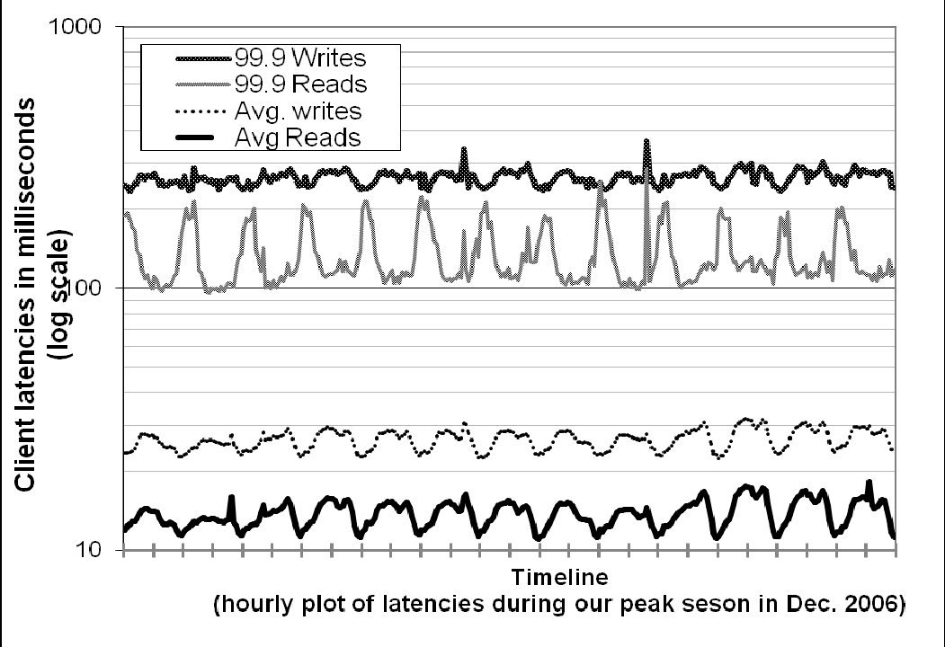
Improving performance at 99.9 percentile
Notes:
Diurnal pattern. Read Latency vs write latency as write needs disk access.

Slide 55
Ensuring Uniform Load distribution
Dynamo uses consistent hashing to partition its key space across it’s replicas.
Assumption: Enough keys so that load of handling popular keys can be spread across the nodes uniformly.
Measure imbalance ?
- Node’s request load deviates from average by a value less than a certain threshold
High load vs low load

Slide 56
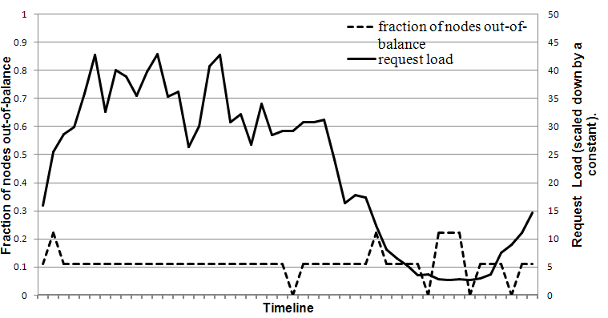
Out of Balance: High Load vs Low Load

Slide 57
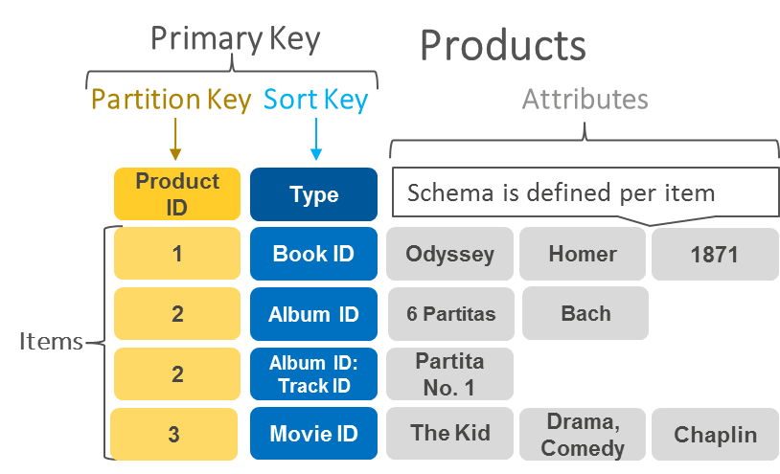
Partitioning Key
Source: Choosing the right dynamodb partition key (aws.amazon.com)
Notes:
Partitioning key is the important aspect in building the scalable and reliable applications on top of dynamo DB

Slide 58
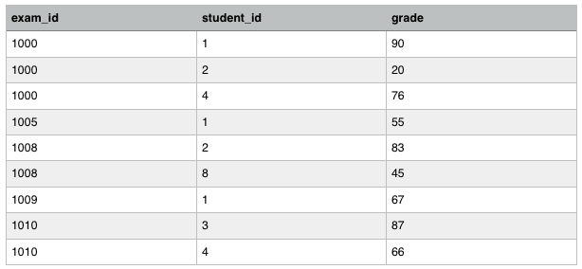
Partitioning Key
Source: Deep dive into dynamoDB solutions [shinesolutions.com]
Notes:
Partitioning key is the important aspect in building the scalable and reliable applications on top of dynamo DB

Slide 59
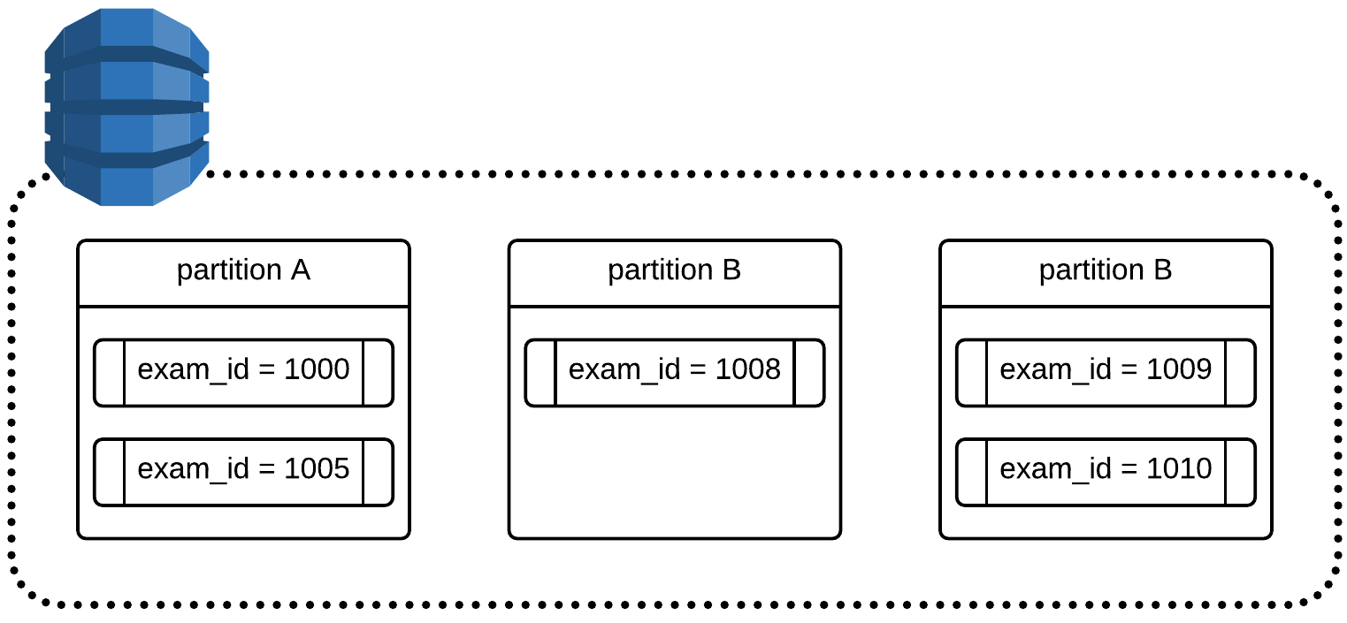
Partitioning Key
Source: Deep dive into dynamoDB solutions [shinesolutions.com]
Notes:
Partitioning key is the important aspect in building the scalable and reliable applications on top of dynamo DB

Slide 60
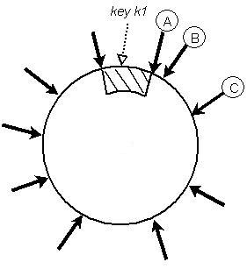
Partitioning Key: Strategy 1
T random tokens per node and partition by token value
Notes:
Partitioning key is the important aspect in building the scalable and reliable applications on top of dynamo DB

Slide 61
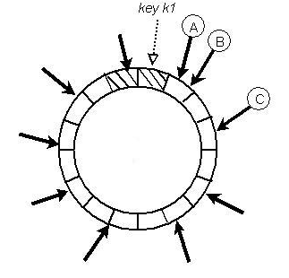
Partitioning Key: Strategy 2
T random tokens per node and equal sized partition

Slide 62
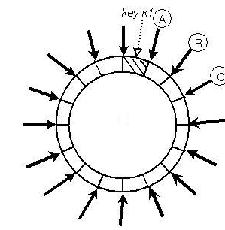
Partitioning Key: Strategy 3
Q/S tokens per node, equal sized partitions

Slide 63
Client- driven vs Server Driven coordination
 | 99.9th percentile read latency (ms) | 99.9th percentile write latency (ms) | Average read latency (ms) | Average write latency (ms)
Server - driven | 68.9 | 68.5 | 3.9 | 4.02
Client - driven | 30.4 | 30.4 | 1.55 | 1.9

Slide 64
Conclusion
Notes:
Suma

Slide 65
Incrementally Scalable
Allow users to customize their storage system to meet their desired performance.
Eventual - Consistent Storage system can be a building block for highly available applications

Slide 66
Thank You
Notes:
Suma

